Slide 1
The
CONTINUUM OF CARE
Essential for Effective Substance Use Disorder
Prevention, Treatment & Recovery Support Services
Notes:
Basic Narrative:
The NH Bureau of Drug and Alcohol Services is committed to developing a robust, effective, and well-coordinated continuum of care for substance use disorders that includes health promotion (sometimes called environmental prevention), prevention, early identification and intervention, treatment, and recovery supports.
This presentation is designed to introduce the components of a robust, effective and well-coordinated continuum of care that encourage communities to support resiliency and recovery and to lay the foundation for public health regions in the state to begin to address gaps in the continuum over time.
Optional Expanded Narrative:
The ultimate goal of a continuum of care initiative for substance misuse is to have:
- Adequate public education and awareness of substance misuse and its risks as well as awareness of the progression of substance use disorders
- Strategies for population health promotion, prevention programming and resiliency development
- Widespread, universal screening in multiple settings and with all populations
- Trained “early identifiers” in a wide range of community settings
- Open, clear communication and referral paths between early identifiers and service providers for general communication and knowledge sharing as well as referrals
- A robust array of services from assessment and early and brief treatment through residential programs and long-term recovery supports
- A collaborative and communication-focused model within communities in the region that relays general and specific information that can act as an early warning system if and when new threats emerge, that moves individuals into appropriate levels of care as quickly as possible, that responds to individual and collective need, and that is continually reflecting on and improving services and supports for residents.

Slide 2
Definitions
Resiliency
Substance Misuse
Substance Use Disorders
Addiction
Recovery
Notes:
Basic Narrative:
Before we begin to look at a continuum of care, we should define a few terms that are used when talking about the continuum of care.
According to NH Bureau of Alcohol and Drug Abuse,
CLICK FOR ANIMATION
Resiliency includes traits or factors that help a person resist harm or to recover more quickly from harm. Resiliency refers to a condition that exists before a problem develops.
CLICK FOR ANIMATION
Substance misuse is any inappropriate, illegal or potentially harmful use of substances, e.g. underage drinking, binge drinking, alcohol use during pregnancy, any illegal drug use, and use of medications in ways other than prescribed.
CLICK FOR ANIMATION
A Substance use disorder is a diagnosable condition that meets specific criteria describing a pathological pattern of behaviors, symptoms and/or consequences related to substance use;
substance use disorders occur in in a range of severity, from mild to severe and include addiction (adapted from the DSM-5)
CLICK FOR ANIMATION
Addiction is a primary, chronic disease of brain reward, motivation, memory and related circuitry that is reflected in an individual pathologically pursuing reward and/or relief by substance use and other behaviors and is characterized by: Inability to consistently abstain Impairment in behavioral control Craving Diminished recognition of significant problems with one’s behaviors and interpersonal relationships Dysfunctional emotional response (adapted from ASAM Criteria)
CLICK FOR ANIMATION
Recovery is a process of change through which individuals improve their health and wellness, live self-directed lives, and strive to reach their full potential (SAMHSA). Resiliency and recovery involve the development of many of the same traits and factors; the term “recovery” refers to a process and condition that exists in response to a problem that has developed.

Slide 3
Whole Person
Whole Community
Notes:
Basic Narrative:
The NH Department of Health and Human Services supports whole-person and whole-community approaches to improving safety, wellbeing, and positive health outcomes. What this means in terms of the continuum of care for substance use disorder services is that our services within specific systems, such as primary care, should consider all aspects of an individual’s life when designing the best care plan for an individual.
It also means that all elements of a person or family’s community should support individual wellbeing, such as recovery-supportive housing and employment, or schools that help identify youth who may be experiencing problems related to alcohol or drug use.
Expanded narrative:
There are three types of factors that pose risk for substance misuse and addiction. No one risk factor is responsible for developing substance use disorders, but it is generally accepted that the greater number of risk factors, the more likely one is to develop a SUD (NIDA).
The three types of factors are biological, social and, psychological. These factors interact with each other, all three influence the individual, and all three can be influenced by the community in which the individual lives.
These categories of factors are keys to understanding the risk and resiliency that an individual has as they mature and are exposed to opportunities to use or misuse substances. They are also factors that characterize susceptibility to developing a substance use disorder or addiction over time – how quickly the disorder progresses, how significantly it manifests itself, and how challenging it will be to halt the progression of the disorder.
Factors that are biological are related to how an individual is wired by their DNA before they ever touch a substance and how their bodies react to a substance introduced to their brain, be it alcohol, marijuana, opiates or other drugs.
Research has shown that children with biological parents who were alcohol dependent, regardless of whether they were raised by that parent, are more likely to have problems with alcohol themselves. Studies have also shown that children who exhibit impulsivity or who have underlying mental health problems that may be biological are at a higher risk for substance misuse and SUDs (NIDA)
NIDA says that genetic factors account for between 40 and 60 percent of a person’s vulnerability to addiction; this includes the effects of environmental factors on genetic factors. A person’s stage of development and other medical conditions they may have are also factors. For example, adolescents and people with mental disorders are at greater risk of drug abuse and addiction than the general population.
In short, each individual is born with a particular make-up that will interact with many contexts, from the family environment and peer group to school, work, and community. Each of those environments will affect risk and resiliency. For example, families with low supervision and strained relations may increase the risk for substance misuse; however, a school with a strong prevention culture and policies may help protect a youth from misuse.
Beyond biological factors, we are influenced by social factors such as peer group influences and wanting to fit in whether we are adolescents or adults. We are also affected by psychological factors such as anxiety, depression or trauma.
Therefore, our risk for substance misuse and addiction is influenced by our genetic, social and psychological makeup but also by experiences and environments throughout our lives, such as prior trauma, the culture of our school or work place (e.g. building trades and hospitality industries have higher rates of substance misuse than other professions) and culture of our community (e.g. Bike Week, beer tent festivals, and roadside billboards advertising and glamorizing alcohol).
The individual and environmental factors affecting substance misuse align with the Bureau’s whole-person and whole-community approach to prevention, intervention, treatment and recovery.
Add information based on your expert panel’s expertise and experiences.

Slide 4
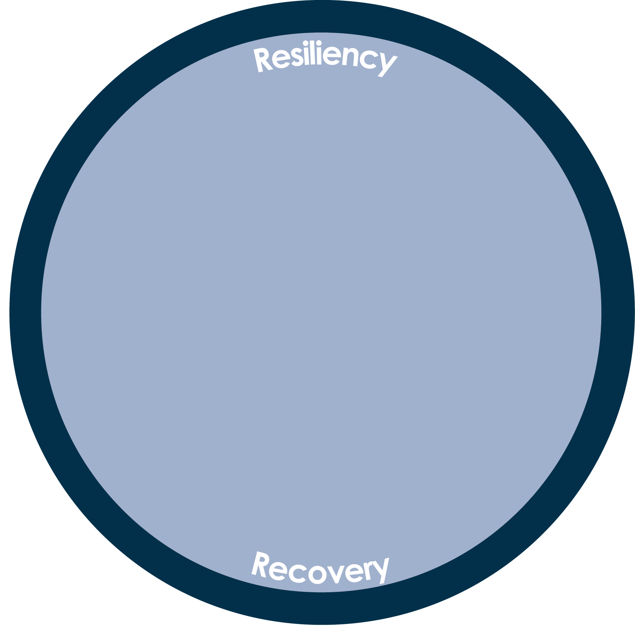
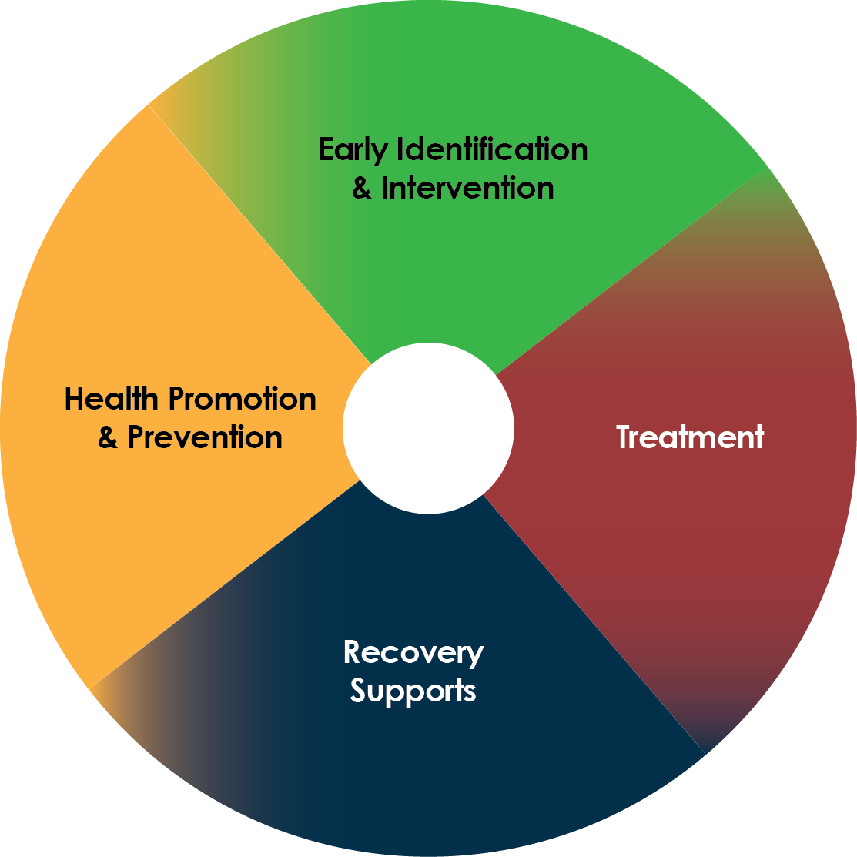
Notes:
Basic Narrative:
Whatever our individual or collective risks, there is opportunity to increase resiliency and recovery through policy and practice change, be it in a family, health care setting, work place, college campus or community event.
The Whole Person Whole Community approach recognizes the importance of developing a coordinated and diverse system of community-based services, strategies and supports that is person-centered and builds on the strengths and resiliencies of individuals, families, and communities.
This reliance on individual, family and community strengths helps us to be proactive in our efforts to prevent substance misuse and to be responsive to individuals who are in or are seeking recovery, thereby increasing their health, wellness, and quality of life.
By recognizing substance use disorders as preventable and treatable chronic conditions needing long-term management and support services, communities can begin to work together to ensure effective and integrated services to prevent risky behavior, to deter the progression of SUDs, and to treat and manage recovery from these disorders.
Add information based on your expert panel’s expertise and experiences.

Slide 5
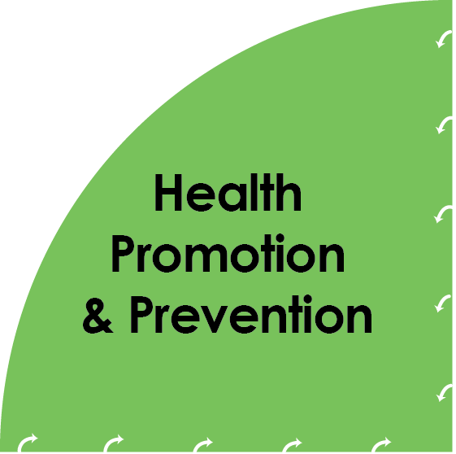
Health Promotion (Environmental Prevention)
Public Service Announcements/Community messaging
Effective policies and practices in communities and organizations such as universal screening and substance-free spaces
Direct Service Prevention
Providing information and building skills to promote resilience
Providing substance-free activities
Providing youth leadership activities
Promoting positive connections to school, work, community, and home
NH’s Regional Public Health Network for Substance Misuse Prevention
Notes:
Basic Narrative:
With definitions and context established, let’s talk about the four components of an effective continuum of care relative to substance misuse and substance use disorders. We’ll begin with health promotion and prevention.
CLICK FOR ANIMATION
Health Promotion consists of environmental strategies that influence the general population, such as policies, media messaging, places and public areas that are substance-free, and universal screening.
Direct Service Prevention consists of specific activities with groups or individuals, such as parent or youth courses that provide information on substance misuse and that build skills to avoid misuse.
Expanded Narrative:
There are many examples of health promotion and prevention services that communities may engage in:
Health Promotion Examples (Environmental strategies for population prevention) Media campaigns for a wide variety of target populations and focus issues
Prevention & Resiliency Oriented Messages, treatment access and recovery messages
Pro-social, substance-free activities
Alcohol, tobacco and drug free public spaces and events
Policy Examples
Effective policies in schools, colleges, workplaces, medical clinics, community law enforcement, others
Student Assistance Screening (schools and colleges)
Athletic and co-curricular policies that support no alcohol, tobacco or drug use
Work place education, pre-employment alcohol/drug screens
Universal Screening of patients for substance use in primary care
Regular patrols of targeted areas and events
Regulations and laws that limit or restrict alcohol, tobacco or drug use
Limits to the number of alcohol/tobacco retailers in a geographic area
Limitations on signs and advertising specific to alcohol and tobacco outside of retail establishments
Regulations restricting sales of alcohol, tobacco or drug paraphernalia and images
Restricting sales of synthetic products used to get high
Direct Service Prevention Examples
Programs such as mentoring to prevent early initiation of alcohol or drug use
Student Assistance Programs in schools and colleges
Required coursework on risks and harm associated with substance misuse, progression of alcohol, tobacco and drug use in schools and colleges
Required educational programs for parents on risks and progression of alcohol, tobacco and drug use
Programs that provide positive, pro-social, academic, and/or other enrichment activities during hours of higher risk for alcohol or drug use, such as after-school, weekend or vacation week programs for school-aged or college aged youth
Workplace education
Add information based on your expert panel’s expertise and experiences.

Slide 6
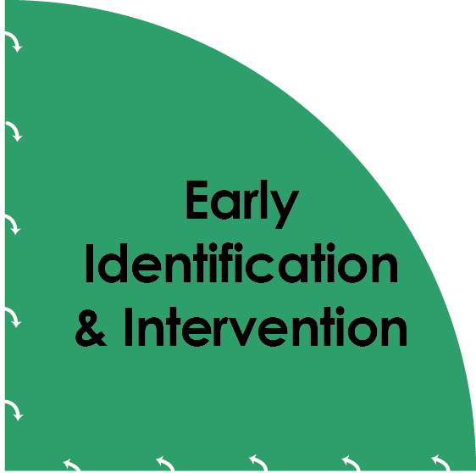
Early Identification
Universal screening and response
Responding to other early warning signs that someone may be misusing substances
Intervention
Educating more specifically about individual, family and environmental risk factors, protective factors and corresponding skills
Assessing the progression of a substance use disorder and co-occurring mental health
Counseling, motivational interviewing and/or additional education to slow/stop progression
Referral to treatment when necessary
Notes:
Basic Narrative:
Early identification and intervention are often a brief but critical component of the system of care because they provide an opportunity to intervene in the development of symptoms before the disorder develops or progresses.
CLICK FOR ANIMATION
Programs, policies and practices that establish an effective means to identify substance use problems early and refer individuals to accessible treatment and recovery options can be instituted in any setting, from a middle school or a primary care office to a requirement of court sentencing or a standard part of a homeless and housing program.
Early identification and intervention is also a point within the continuum of care where communication between services providers and community systems is most important. This is because communication and positive relationships between organizations can help identify services available in the community and find places to access care and support.
Optional Expanded Narrative:
Early Identification/ Intervention Examples
- Student Assistance Programs in schools and colleges
- Employee assistance programs (formal or informal) in workplaces
- Screening and brief interventions for justice/court-involved youth, young adults, adults and families
- Community-based programs that encourage clients to self-refer for assessment and referral for services
SBIRT (Screening, Brief Intervention and Referral to Treatment) in medical settings
Add information based on your expert panel’s expertise and experiences.

Slide 7
Pre-treatment
Assessment of disorder
Level of care determination
Treatment planning
Treatment
- Withdrawal management
- Outpatient counseling
Intensive outpatient treatment
Medication Assisted Treatment with buprenorphine, methadone, other medications
Partial hospitalization
Residential treatment
Recovery plans
www.nhtreatment.org
Notes:
Basic Narrative:
Treatment for substance use disorders varies from person to person and is adaptable to the individual’s needs and progress.
CLICK FOR ANIMATION
Pre-treatment involves conducting a formal assessment, determining the appropriate level of care and developing a treatment plan in response to the assessment.
Assessments typically help identify the nature and severity of problems the person is experiencing related to substance misuse, any related mental health concerns such as depression or anxiety, as well as the strengths and supports the person has in his/her life. This focus on strengths during the assessment is an important element of the whole-person approach and a successful treatment program.
An assessment typically uses criteria from the American Society of Addiction Medicine (or ASAM) to determine the level of care needed, which may range from outpatient counseling at lower levels of acuity to partial hospitalization or residential treatment at higher levels. SUD treatment may be integrated with treatment of mental health conditions and physical health problems. Medication assisted treatment may be suggested for opioid dependence or other SUD conditions to complement counseling at various levels of intensity. ASAM is also used by insurance companies to determine coverage levels.
In some cases, the first step may be services to help the individual withdraw safely from the physical effects of the alcohol or drug’s presence in the body. Withdrawal management typically lasts a few days, after which the person transitions to another level of care.
The duration of treatment will vary depending on the severity of the individual’s disorder, the level of support the individual has at home and in the community during treatment, and other context. Transitioning from treatment involves developing a long-term recovery plan that identifies natural supports, a primary care professional to connect with, community support groups, and other resources that the individual can connect with to support their continuing recovery.
In this component of the continuum of care for SUDs, community sectors can be supportive of individuals they interact with who are seeking treatment, such as adjusting school or work hours to accommodate treatment appointments, and by encouraging family and friends of the person seeking treatment to become more educated in the aspects of the disorder and its treatment.
It is important to note that because SUDs are a chronic disorder characterized by periods of setbacks as well as progress, people may move from one level of acuity to another and back as they learn to manage triggers, the influence of friends and family, and stress.
In New Hampshire, one can find treatment options in the state by visiting www.nhtreatment.org.
Optional expanded narrative:
Treatment
Ideally, treatment is an interconnected, integrated service available within multiple community systems, such as primary care, prenatal care, pediatrics, mental health counselors and clinics, elder services, courts, schools and colleges, etc.
Treatment services may also offer relapse prevention services such as weekend sessions, recovery coaching, and 24 hr phone support
Add information based on your expert panel’s expertise and experiences.

Slide 8
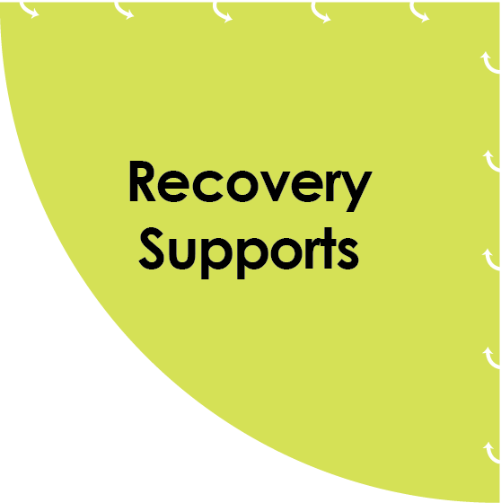
Recovery Supports
Recovery coaching/mentoring
Peer support groups
Transitional housing
Long-term sober housing
Substance-free activities
Recovery-supportive health care, employment, education, and community environments
Ancillary Recovery Supports
Child care and transportation
Job training/employment counseling
Personal finance skill building
Relationship skill building
Stable housing & employment
Volunteer opportunities/giving back
Notes:
Basic Narrative:
Once a person’s SUD is being successfully managed, recovery supports are essential to provide long-term support. These supports may involve basic needs such as finding housing, employment, child care, and social activities that do not involve alcohol or other drug use.
CLICK FOR ANIMATION
Recovery supports may also be specific to the SUD such as finding and attending peer support meetings and finding a recovery coach for regular check-ins.
Schools, employers, primary care settings, and community-based organizations can be important parts of a person’s long-term recovery; for example, providing time and opportunity for support meetings, life skills development, and on-going health care supports long-term recovery.
This part of the continuum is also a connection to the beginning of the cycle where a community works together to promote individual and public health and send consistent prevention messages and healthy norms. People in recovery and their family members can help communities identify problem areas and develop responses to issues and settings that support recovery, thereby also promoting prevention.
Optional Expanded Narrative:
Recovery Supports may include:
- Community-based services that support individuals in early and long-term recovery
Recovery centers available for a wide range of supports from employment counseling and social activities to housing support and respite child care
Sober living facilities
24/7 call center
Recovery mentors and peers
Recovery supports within community institutions may include:
Schools and colleges that provide recovery groups and services
Recovery-friendly workplaces and employers
Recovery-friendly social places and events
Peer-led support groups
Community awareness events in support of recovery
Add information based on your expert panel’s expertise and experiences.

Slide 9
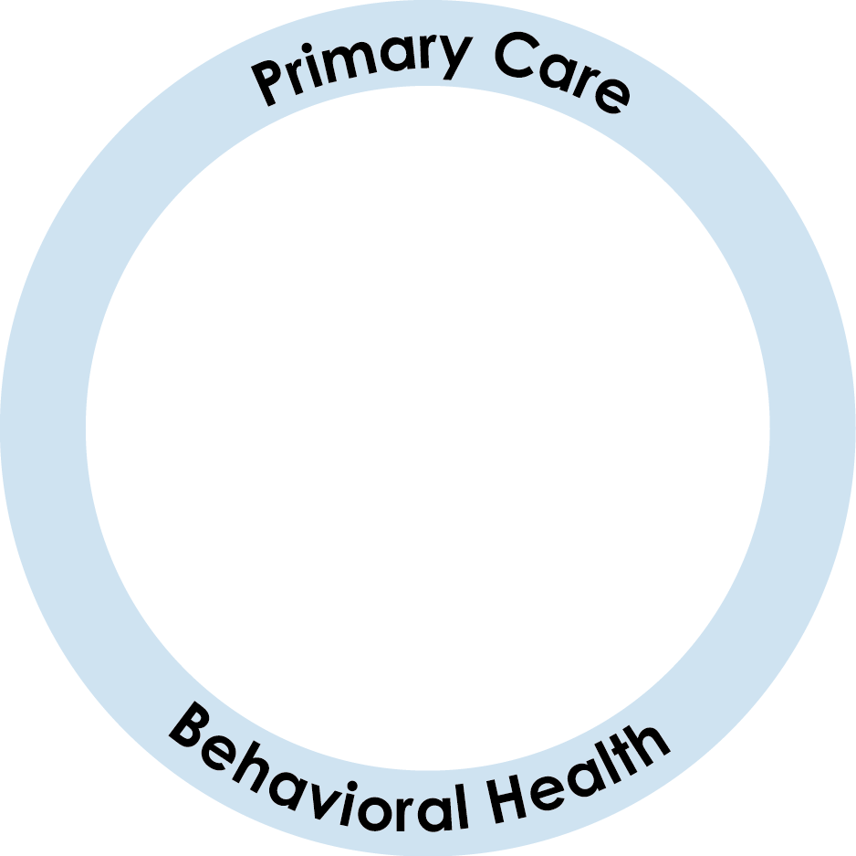
Notes:
Basic Narrative:
When the continuum of care interacts closely with the primary care and behavioral health systems in a community, there are many benefits to the individual and to the community-at-large.
CLICK FOR ANIMATION
Close interaction, characterized by regular, positive communication, bi-directional referrals, interagency agreements, and/or integrated data and billing systems, can lead to many positive outcomes, such as:
More awareness and knowledge of SUDs across all service levels and staff
Smoother transitions between levels of care
Services that align closely with individual need
More wrap around care and supports
Better patient outcomes
These outcomes bring the continuum full circle to a prevention-prepared community that can quickly and effectively prevent health problems, identify and respond quickly, deliver appropriate treatment as early as possible, and support all stages of recovery.
The core sectors within a community can further support a robust and effective continuum of care – by promoting health and delivering basic prevention services,
--by helping people identify problems they may be having with alcohol or other drug use early, and helping them find assessment and treatment services quickly, and
-- by supporting people in their long-term recovery goals.
CLICK FOR ANIMATION
These sectors, represented by the icons on the slide, include schools and other education programs, courts and law enforcement, businesses, health and medical services, local and county government, and community-based organizations.
All can be educated about the pervasiveness and negative outcomes of alcohol and other drug misuse.
All can support prevention and early identification.
And all can support people they work with every day in their recovery needs.
Together, services and systems, professionals and community members, can work toward an effective continuum of care for a disorder that can be debilitating, and yet is a disorder that is100% preventable and treatable, without stigma and without barriers to recovery.

Slide 10
What is Our Community’s Vision
for a robust, effective continuum of care?
Notes:
The information shared today articulates the state’s framework for a robust, effective continuum of care for substance misuse and substance use disorders in NH communities.
Our next step as providers, stakeholders and citizens is to develop a vision of what such a continuum might look like here in our community.
Expert panels may lead this visioning in a variety of ways and settings.

